Slide 1
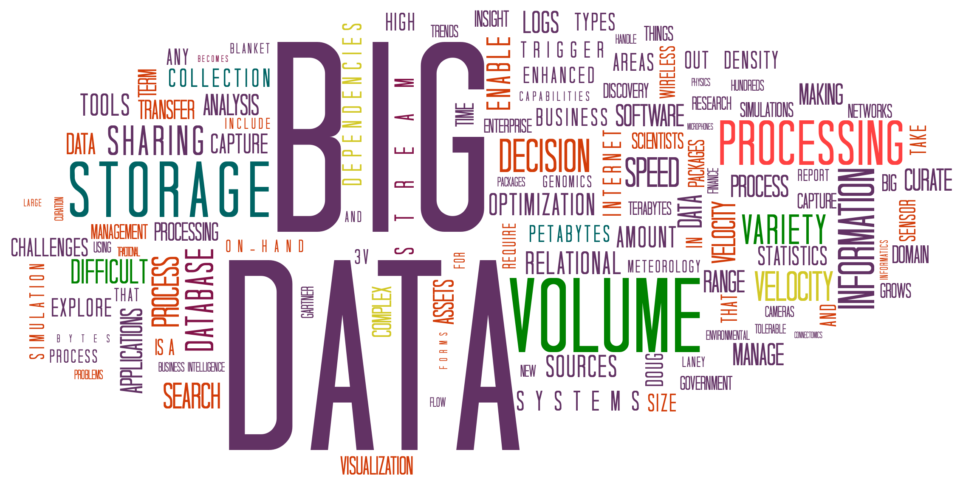

Welcome to Big Data Analytics
www.seas.upenn.edu/~cis5450
Zachary G. Ives
University of Pennsylvania
CIS 5450 - Fall 2023
Portions of this lecture were developed for the OpenDS4All project,
piloted by Penn, IBM, and the Linux Foundation
https://tinyurl.com/cis-5450-8-30-2023
Notes:
Up next: Who’s Who (S)

Slide 2
Welcome!

Slide 3
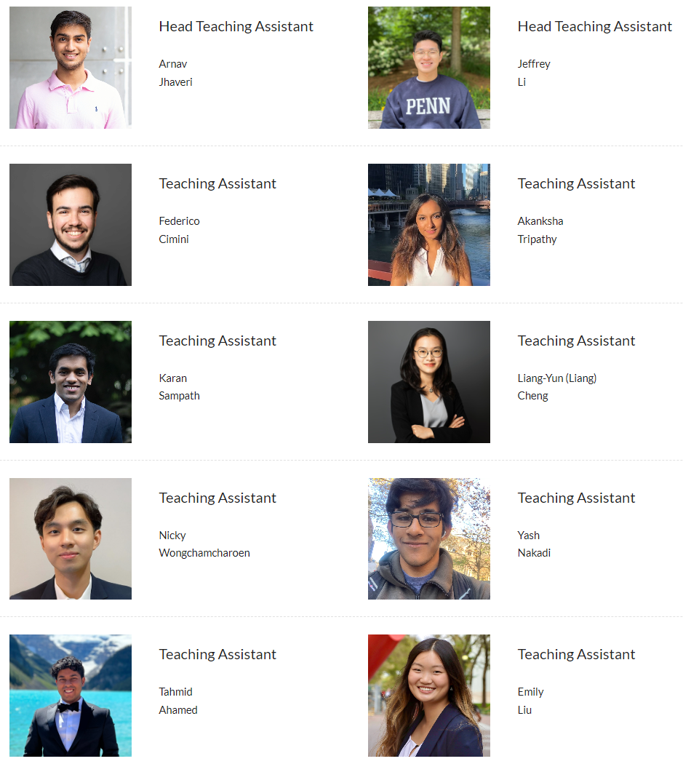
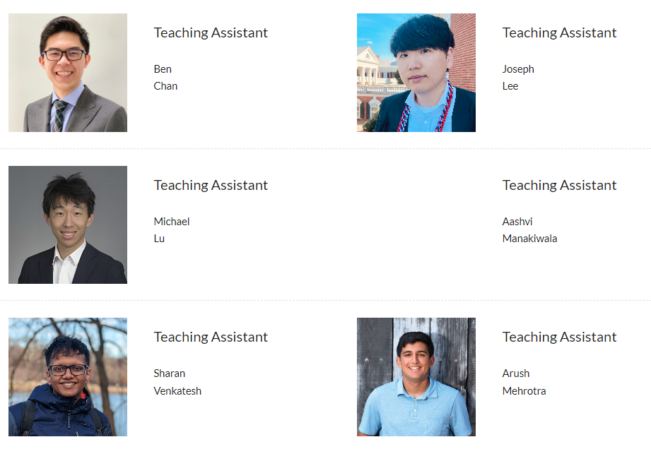
Get to Know Your Fantastic TAs, and Stop by Our Office Hours

Slide 4
Waitlists
We know there are many requests to get into the class!
Currently: we are limited by the room capacity of 340
Some folks who have signed up will drop, so there will be “churn” over the next 2 weeks
We are exploring options to add a second grad-only section, which may add flexibility in our cap
If you attend class, you’ll get priority among the folks who don’t
And also note we offer the course (with 60 more seats) in Spring!
https://tinyurl.com/request-5450

Slide 5
Motivation for the Course: Data Is Driving Everything
Modern data acquisition is inexpensive!
Smartphones, embedded systems, inexpensive sensors,
Medical devices, simulators, …
Data storage is inexpensive!
Parallel (compute cluster) computation is inexpensive
The Cloud, clusters of computers, GPUs, tensor processors, …
Science only has explanatory and predictive models in a few (mostly physical sciences-related) domains
... So: can we use algorithms + data to understand phenomena? Build or augment models? Build detectors? Make diagnoses?
Notes:
Up next: Buzz Words

Slide 6
Data Is Driving Buzzwords
“Deep learning”
“Statistical analysis”
“Biomedical informatics”
“Business analytics”
“Large language models”
“Big data”
“Data science”
“Data lakes”
“Visual analytics”
Lots of trends in pursuit of the same goals! Discovery, models, decision-making, …
Also, new issues -
“Ethical algorithms”
“Reproducibility”
Notes:
Up next: Outline (C)

Slide 7
The Key Question in Big Data Analytics: How Do We Understand and Predict?
Much of science and engineering derives from physics, which is “model-first”
Newton’s laws, the theory of relativity, optics, how materials react under stress, etc.
Here, the basis of prediction – even with stochastic processes – tends to be simulation
Weather forecasting, simulating water in the movie Moana, etc.
We want predictions where we don’t have good models
e.g., behavior, biology, the brain, whether a product will be a success, what to invest in
We need to use sampling, statistics, data-first approaches
The big data revolution is mostly about how to acquire and handle enough data, and ask the right questions, for these models to be useful!
Of course, in the real world we often want to combine partial models and data!

Slide 8
Outline for Today
More on Big Data – why it’s hard to:
Capture and model data, and get into into an analyzable form
Visualize, understand, and analyze data
Course logistics, goals, and focus
Notes:
Sue
Up next: Clean Link Model (S)

Slide 9
The Need to Model, Clean, and Integrate Data
Zachary G. Ives
University of Pennsylvania
CIS 5450 - Fall 2023
Portions of this lecture were developed for the OpenDS4All project,
piloted by Penn, IBM, and the Linux Foundation
Notes:
Up next: Who’s Who (S)

Slide 10
Our Focus in Big Data Analytics
Our goal: understand how to manage and create predictive models from big data
machine learning, distributed computing, distributed algorithms, data ethics, …
You’ll understand foundations and principles of data management, machine learning, cloud systems, and more
You’ll be able to do a lot, and be equipped to rapidly learn even more!
Two main aspects: getting data into the right form and building models…

Slide 11
The Journey from Data to Models
Raw Data
(Observations sampled from the world)
Structured, Cleaned, Integrated data
(Data in a form that is meaningful)
Extracted Features
(Measurable characteristics)
Descriptive or Inferential Model
(Of the world, not just observations)
Part I
Part II

Slide 12
What Makes Data “Big”?
A thousand rows? A GB? A PB? A YB?
A Million records? Billion records? Trillion records?
No consensus definition, but from our perspective:
Too complex for a human to understand directly
Doesn’t fit into a single computer’s memory
Needs more than brute force algorithms to analyze
May require multiple computers to work together to process
May have many dimensions
May be changing rapidly (high velocity)
Notes:
Up Next: Data Analytics (S)

Slide 13
Even at Scale, Raw Data Is Hard to Interpret
If you’re given: 66 105 103 – what does it mean?

Slide 14
Interpretability Is Helped by Metadata
65 | A
66 | B
67 | C
68 | D
69 | E
70 | F
71 | G
72 | H
73 | I
74 | J
75 | K
76 | L
77 | M
78 | N
79 | O
80 | P
81 | Q
82 | R
83 | S
84 | T
85 | U
86 | V
87 | W
88 | X
89 | Y
90 | Z
97 | a
98 | b
99 | c
100 | d
101 | e
102 | f
103 | g
104 | h
105 | i
106 | j
107 | k
108 | l
109 | m
110 | n
111 | o
112 | p
113 | q
114 | r
115 | s
116 | t
117 | u
118 | v
119 | w
120 | x
121 | y
122 | z
If you’re given: 66 105 103 – what does it mean?
What if I tell you these are character codes?
B i g
“Raw” data is less useful than data with information about how to interpret it!
Notes:
ASCII table subset from Wikipedia, https://en.wikipedia.org/wiki/ASCII

Slide 15
Interpretability Is Helped by Metadata
Cominarty | 2021
Nuvaxovid | 2022
Spikevax | 2022
What is this a list of?

Slide 16
Interpretability Is Helped by Metadata
Vaccines
Name | Approval
Cominarty | 2021
Nuvaxovid | 2022
Spikevax | 2022
What is this a list of?
The names of recent vaccines for COVID 19…

Slide 17
We Want to Know Structure (Schema), Meaning, and Provenance
Knowing these are vaccine names + FDA approval dates helps interpret the data
Also important why these names and dates were collected!
And useful to know who collected and provided the data (and how)!

Slide 18
Data (Pre)processing Tasks as Done by a Data Scientist / Engineer
Extract the key parts of the data
Model and annotate the data
Clean the data
Link and coregister the data

Slide 19
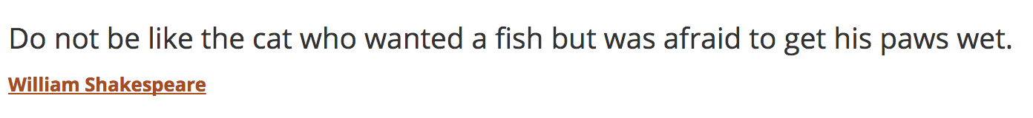
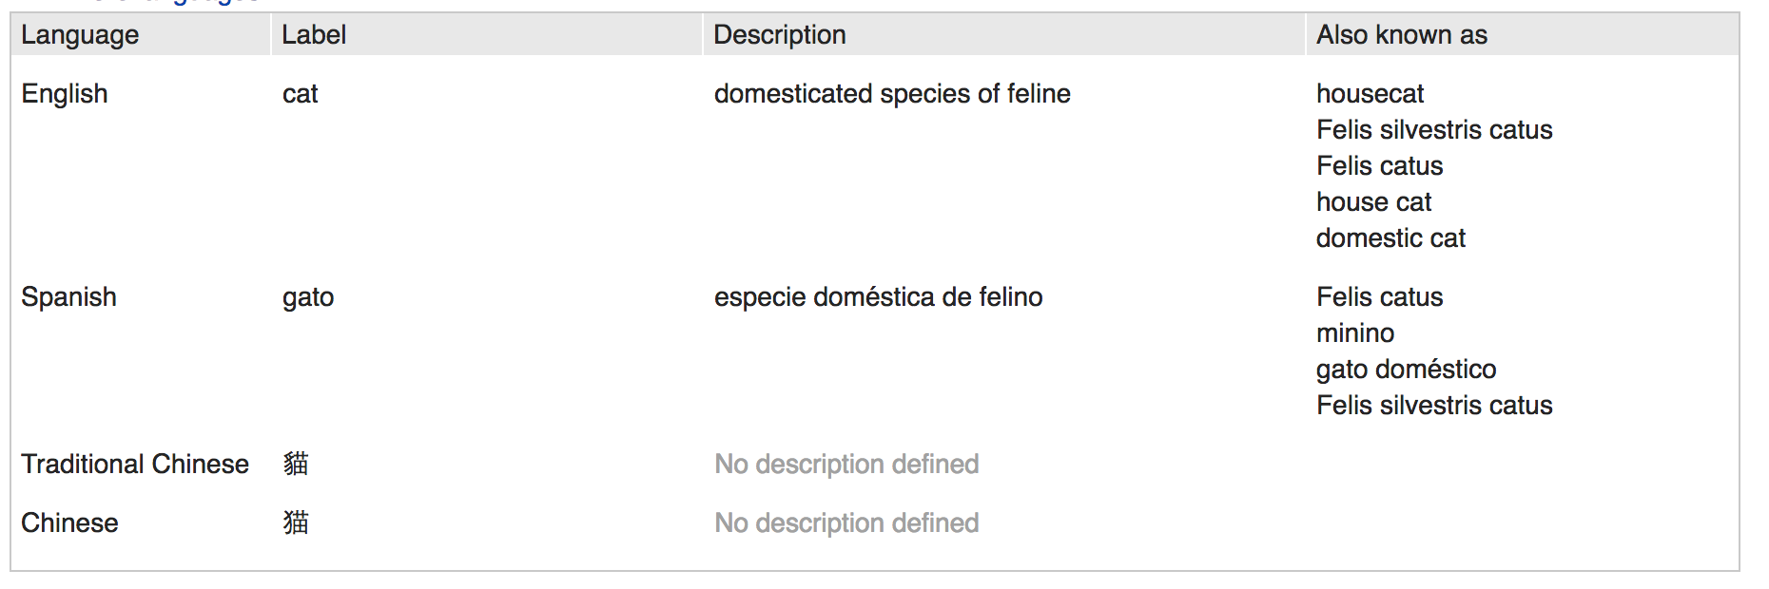

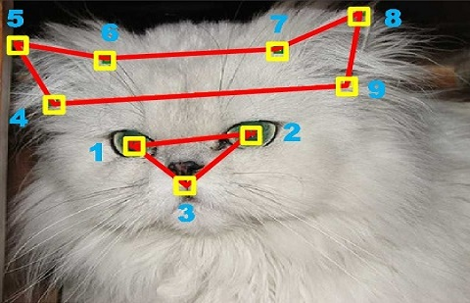
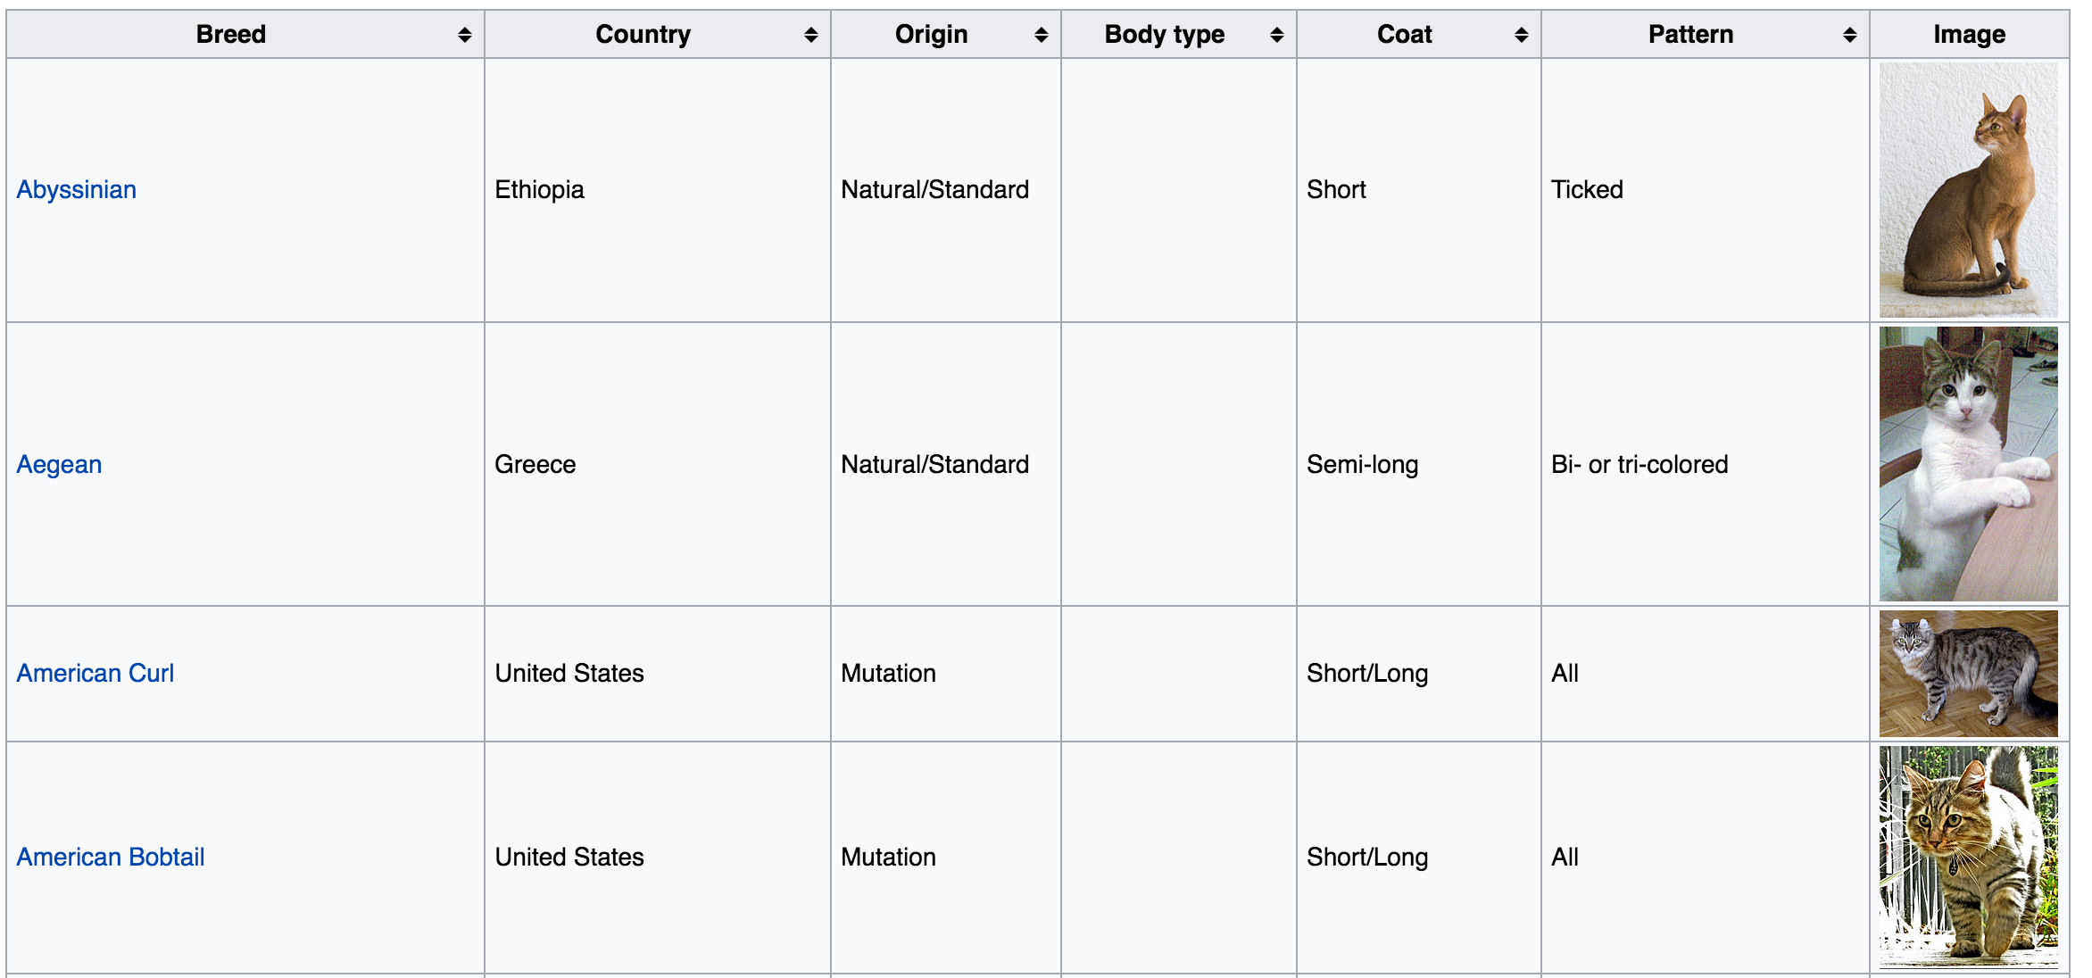
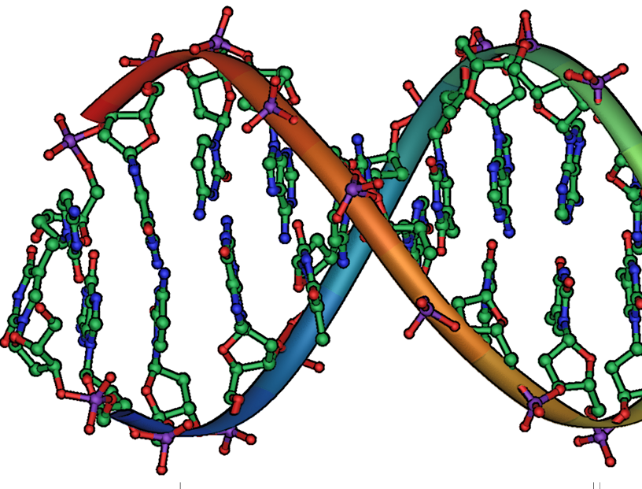
Many Data Modalities Contain Structure
Text
Images
Extract structured data from raw
Genes
Notes:
Credits: Wikipedia, https://people.eecs.berkeley.edu/~junyanz/cat/cat_papers.html,
Wikidata

Slide 20
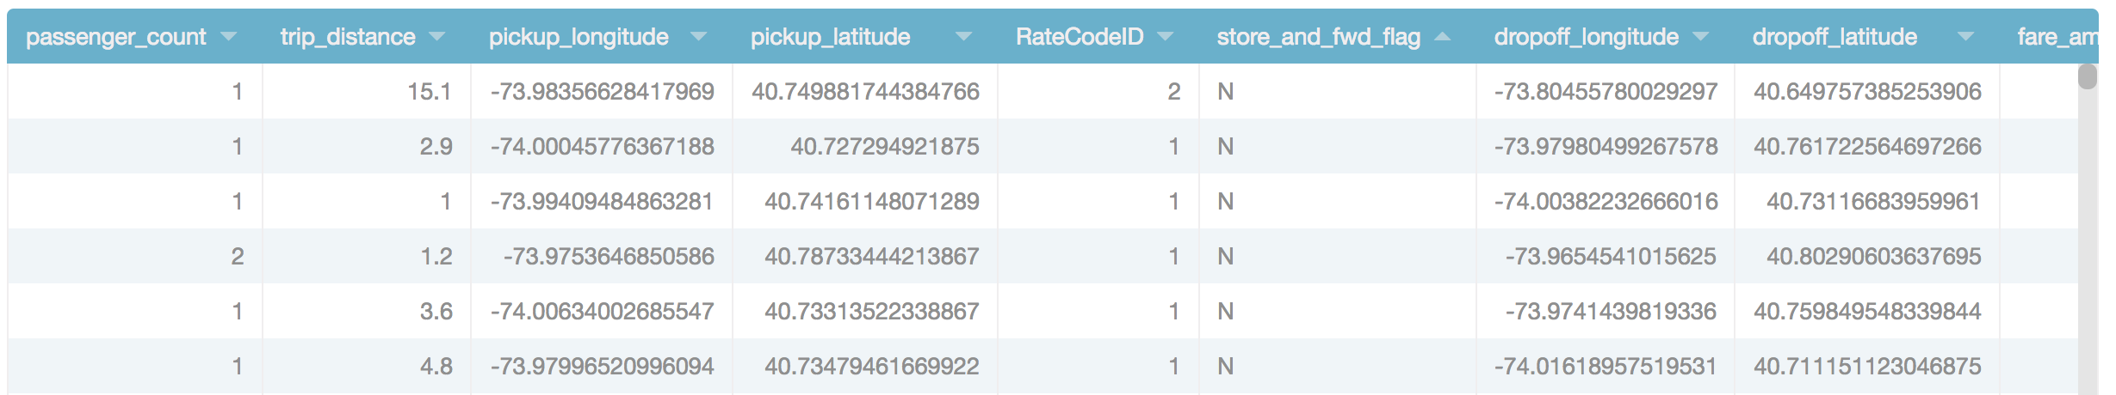
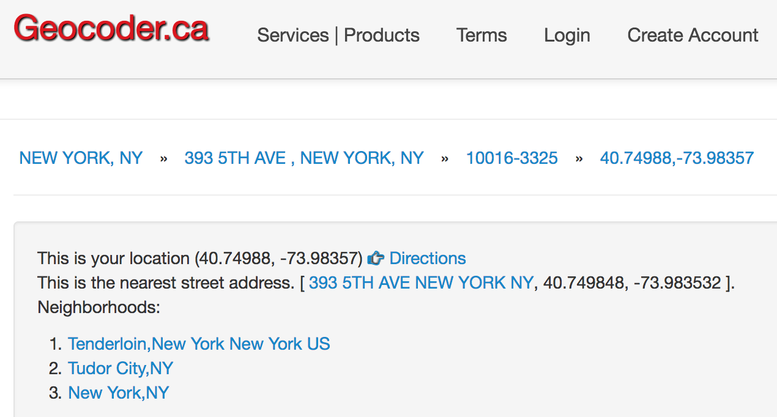
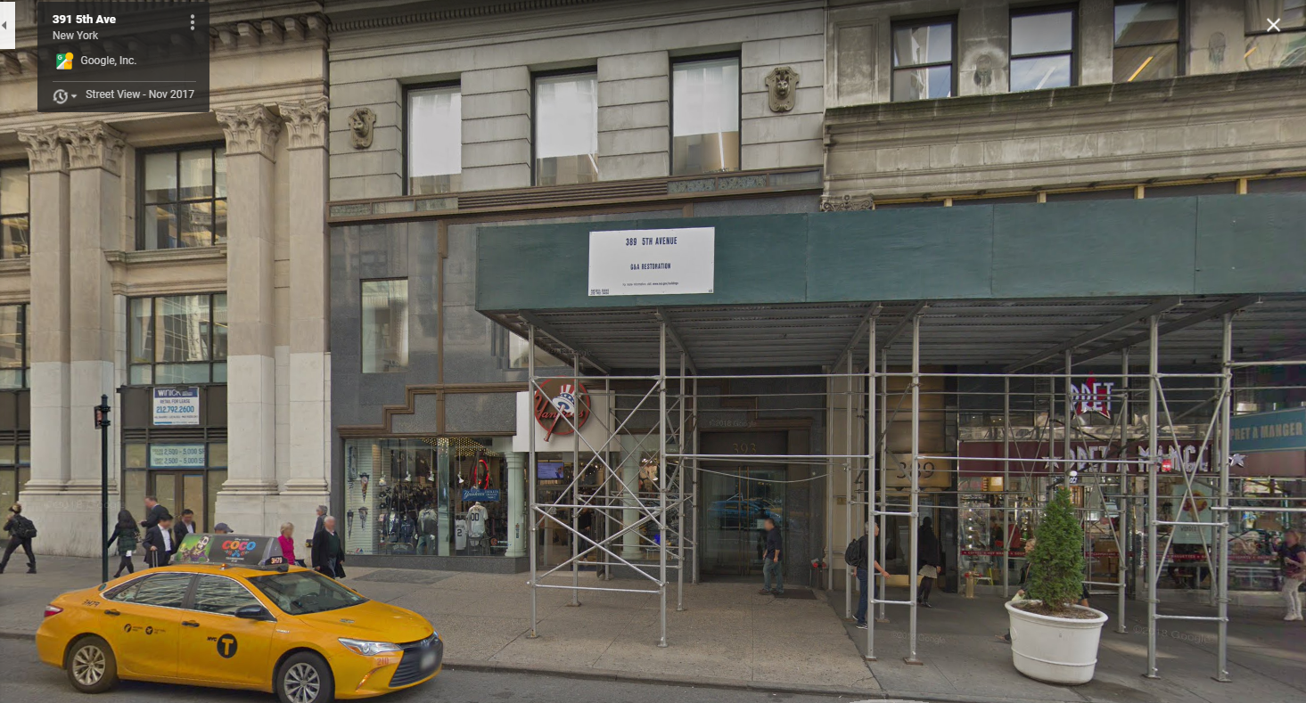
Data often Needs to be Linked across Sources and Even Code!
New York Taxi Data
Reverse Geocode Data
Street View
Notes:
https://data.cityofnewyork.us/Transportation/2015-Yellow-Taxi-Trip-Data/ba8s-jw6u
Up next: How big? (Z)

Slide 21
The Story So Far: Big Data Must be Cleaned & Integrated
Raw Data
(Observations sampled from the world)
Structured, Cleaned, Integrated data
(Data in a form that is meaningful)
We seldom have all of our “big data” directly available
Pieces in different systems or organizations, across documents, databases, APIs, etc.
Requires extraction, modeling, cleaning, and linking
May also do exploratory data analysis and build descriptive models over the data
Part I of the course will focus on this, at scale!

Slide 22
Brief self-check
https://canvas.upenn.edu/courses/1741973/quizzes/3115665
Quiz 01B on Canvas, linked to the Course schedule.
Which of the following is least likely to be a good example of big data?
Points on the trajectory of a falling object
Purchase behavior for 1000 users
1000 YouTube videos
100s of gene sequences
Which of the following tasks is not part of preprocessing data?
Clean the data
Model and annotate the data
Extract the key parts of the data
Run machine learning algorithms on the data

Slide 23
Features and Learning
Zachary G. Ives
University of Pennsylvania
CIS 5450 - Fall 2023
Portions of this lecture were developed for the OpenDS4All project,
piloted by Penn, IBM, and the Linux Foundation
Notes:
Up next: Who’s Who (S)

Slide 24
The Journey from Data to Models
Raw Data
(Observations sampled from the world)
Structured, Cleaned, Integrated data
(Data in a form that is meaningful)
Extracted Features
(Measurable characteristics)
Descriptive or Inferential Model
(Of the world, not just observations)
Part I
Part II

Slide 25
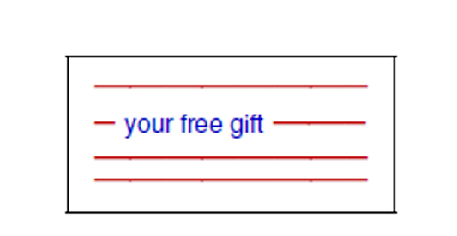
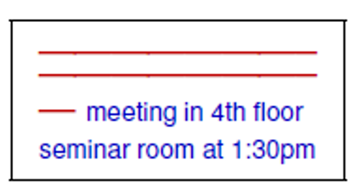
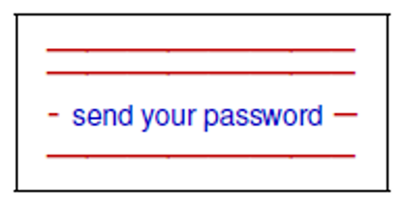

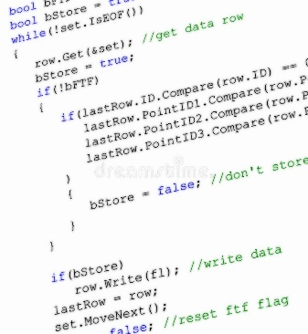
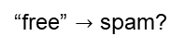
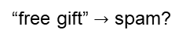

Traditional Programming
Input
Spam
Not Spam
Spam
Output
“free gift” $→$ spam?
Program
“freee gift” $→$ not spam?
“free” $→$ spam?

Slide 26
(Supervised) Machine Learning
Input
Spam
Not Spam
Spam
Output
Program

Slide 27
(Supervised) Machine Learning
Input
Spam
Program
Not Spam
Spam
Output

Slide 28

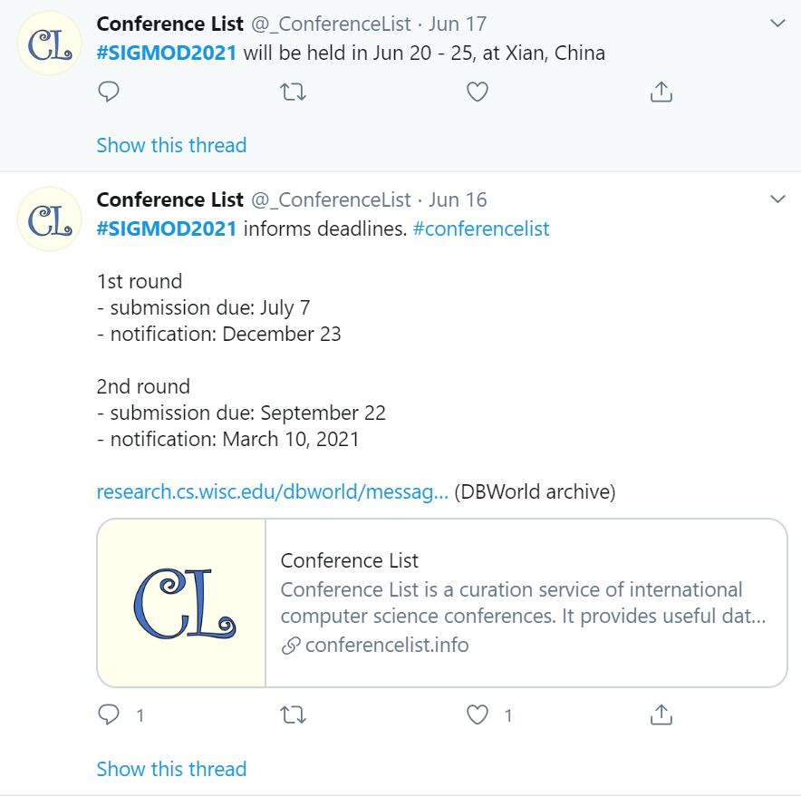
Text Data … And LLMs
Features
Conference | Year | Deadline 1 | Held in
SIGMOD | 2021 | 2020-09-22 | Xi’an

Slide 29
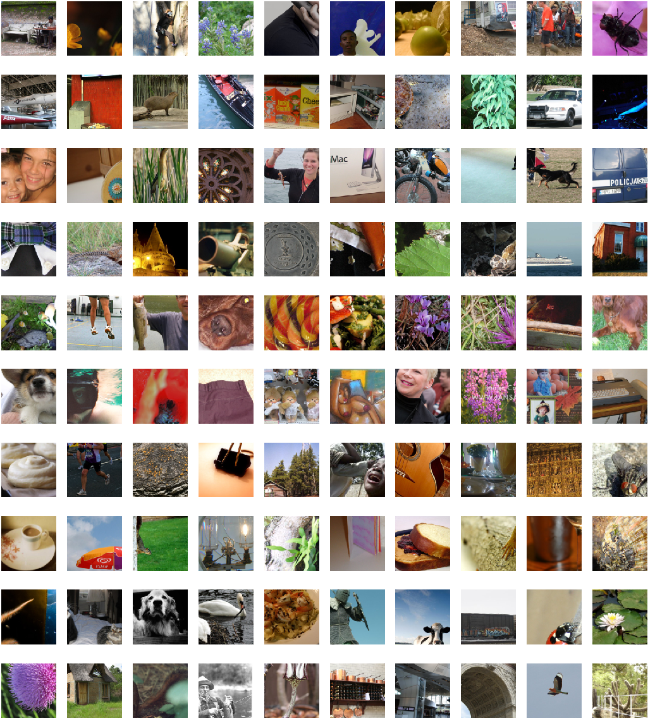
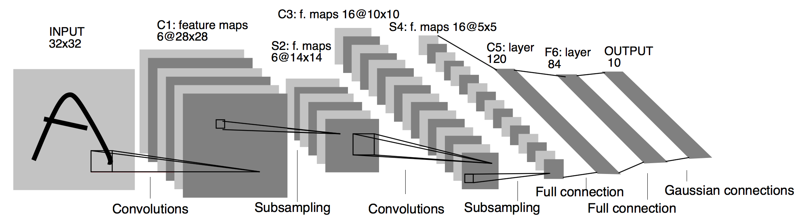
Image Data
Features
representing
shapes, colors, boundaries
Convolutional neural network
Predictions
or classes
Notes:
Imagenet image from https://mf1024.github.io/2019/06/22/Create-Pytorch-Datasets-and-Dataloaders/

Slide 30
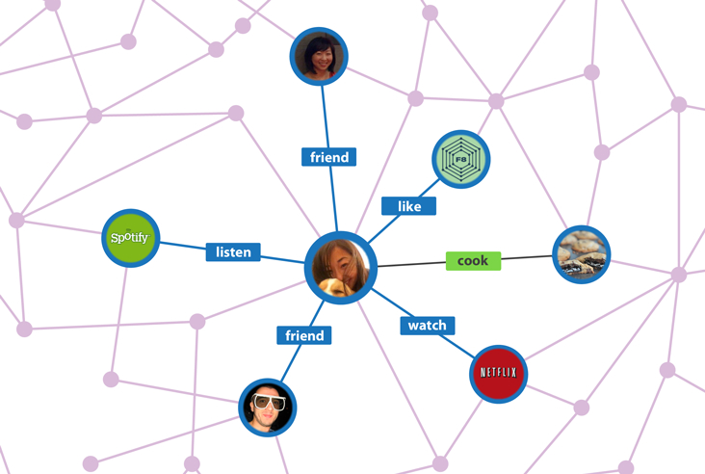
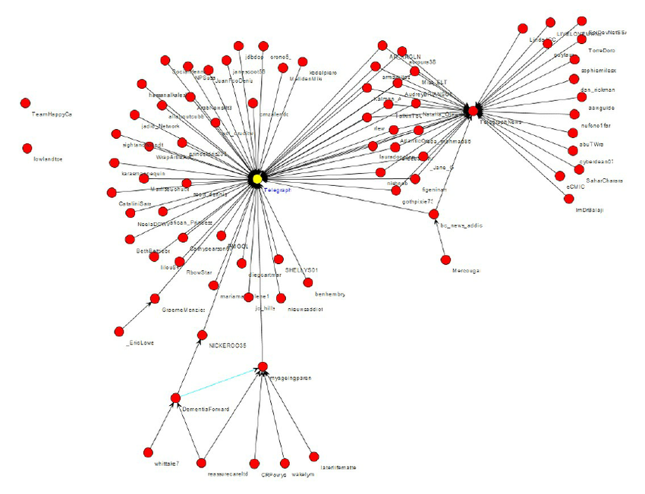
Network Data: Find Patterns in Connectivity (Clusters, Paths, …)
Notes:
Facebook graph: https://www.google.com/url?sa=i&rct=j&q=&esrc=s&source=images&cd=&cad=rja&uact=8&ved=0ahUKEwiG-NS3pszYAhUiYt8KHUMFCH4QjRwIBw&url=http%3A%2F%2Fwww.businessinsider.com%2Fexplainer-what-exactly-is-the-social-graph-2012-3&psig=AOvVaw2D5Cm84V0EKbfEKCIh2EYF&ust=1515635983002846
Retweet graph: https://www.researchgate.net/figure/266968024_A-sample-basic-retweet-graph

Slide 31
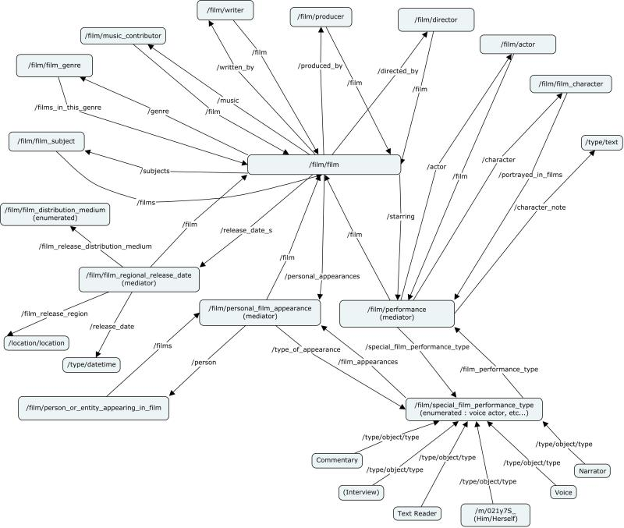
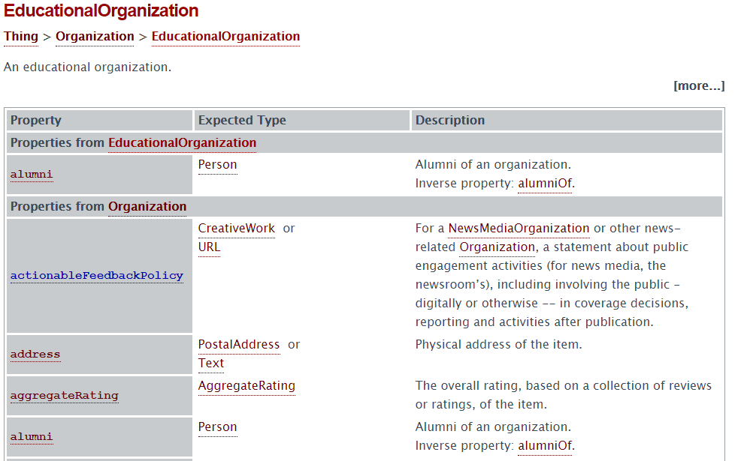
Data with Complex Semantics: Knowledge Graphs
Classes, subclasses, instances, and properties
Notes:
Freebase figure from: https://dzone.com/articles/associative-data-modeling-demystified-part-iv
EducationalOrganization from schema.org

Slide 32
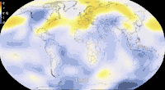
Spatiotemporal data: Track over Time, Potentially Forecast the Future
Notes:
https://giphy.com/gifs/climate-change-visualization-global-warming-hPovBcQ3c1g9W

Slide 33
Summary
Part II involves taking data, extracting relevant features
Then building models via machine learning algorithms

Slide 34
Brief Self-Check
Quiz 01C on Canvas, linked to the Course schedule.
https://canvas.upenn.edu/courses/1741973/quizzes/3115653
Features are:
Unique properties of the data
Any kind of property of the data
Always learned
Values used to predict classes or groups
Which of the following is not a common type of feature:
Specific words in text
Paths associated with a node in a network
Particular shapes or boundaries in an image
A document

Slide 35
Data Analytics Tasks and Goals
Zachary G. Ives
University of Pennsylvania
CIS 5450 - Fall 2023
Portions of this lecture were developed for the OpenDS4All project,
piloted by Penn, IBM, and the Linux Foundation
Notes:
Up next: Who’s Who (S)

Slide 36
The Goal of Data Analytics: From Data to “Knowledge” or Action
Pattern detection: Raw data → patterns → partial understanding
“Show me sales by region by product category”
“Show me clusters of documents by concept”
“Data cubes” (sales by region by quarter by type of product)
Typically, descriptive statistics… or we can find structures to cluster data
Hypothesis → experiment over sample → significance
“Behavioral factor F leads to higher risk of outcome O”
Do statistical test, measure significance vs. null hypothesis
Typically, inferential statistics
Or we use the sample to build a predictive model or classifier
Notes:
We’re gonna recite it. It’s gonna be awesome.
Up next: CERBA in this course

Slide 37
What Does Big Data Analytics Involve?
Acquisition, access – data may exist without being accessible
Wrangling – data may be in the wrong form
Integration, representation – data relationships may not be captured
Cleaning, filtering – data may have variable quality
Hypothesizing, querying, analyzing, modeling – from data to info
Understanding, iterating, exploring – helping build knowledge
And: ethical obligations – need to protect data, follow good statistical practices, present results in a non-misleading way
Notes:
Up next: example 1, a recommender system (C)

Slide 38
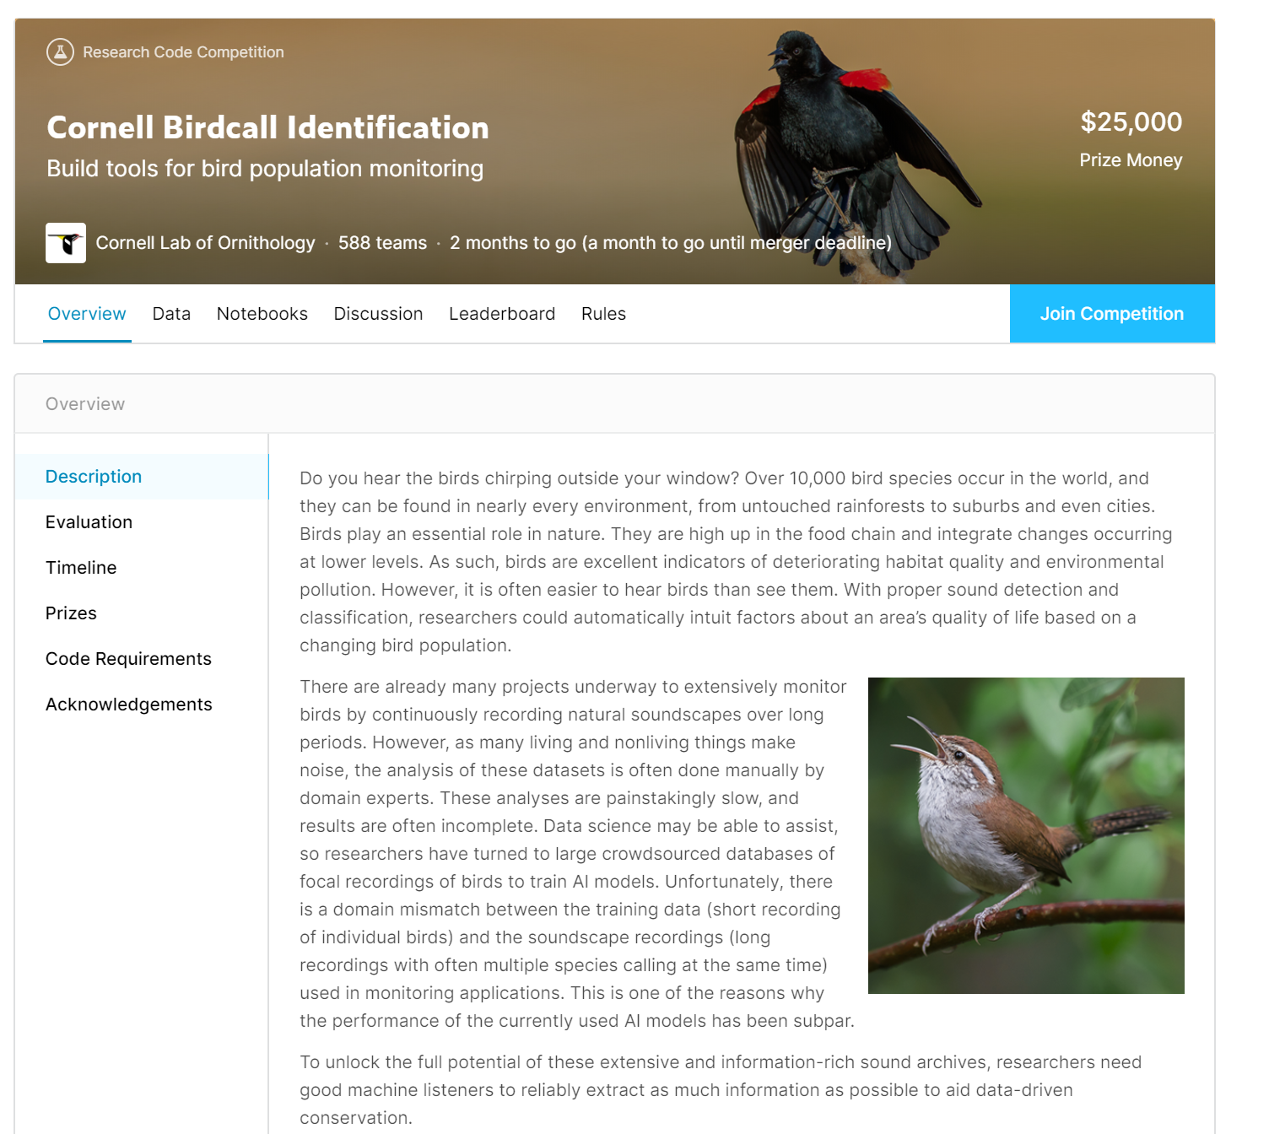

An Example from Kaggle.com
Notes:
https://www.kaggle.com/c/birdsong-recognition

Slide 39
Data Science / Data Analytics: Beware Over-Hyped Expectations!
Data science myth:
We’ll learn everything “bottom up” using fancy statistics and machine learning
Basically we “turn the crank” and out pop insights!
Data + algorithms → knowledge
Data science reality:
We’ll typically rely on human expertise to impose models over the data, the features, etc.
Deep learning can do feature selection – but why throw away what we know!
Data + human insight + algorithms + iteration → information → knowledge
Notes:
Up next: the application process (C)

Slide 40
Data Science Process (Workflow, Lifecycle)
What question are you answering?
What is the right scope of the project?
What data will you use?
What techniques are you going to try?
How will you evaluate your results?
What maintenance will be required?
Notes:
Up next: words from Industry (Z)

Slide 41
The Word from Our Students and Collaborators at Data Science Companies
80-90% of their work involves:
Working with experts to understand the domain, assumptions, questions, etc.
Trying to catalog and make sense of the data sources
Wrangling, extracting, and integrating the data
Cleaning the wrangled data
… Before we get to feature extraction and machine learning!
A bit of this can be obtained with clever “prompting” of LLMs, but most has to be done by human experts (i.e., you!)
Notes:
Up next recap motivations (Z)

Slide 42
Recapping Our Motivations for Big Data Analytics (and this Course)
Big data:
High-dimensional
Hard to understand
Requires understanding computation and I/O costs
Need to add semantic structure, integrate data, extract features
Discovery, hypothesis testing, clustering, classification, recommendation!
Notes:
Course Logistics (S)

Slide 43
Brief Self-Check
Quiz 01D on Canvas, linked to the Course schedule.
https://canvas.upenn.edu/courses/1741973/quizzes/3115692
In data science, human expertise in the problem domain helps with all of the following except:
Filling in missing data
Determining the right features
Supplying computational resources
Formulating the appropriate hypothesis
Understanding, cleaning, and wrangling data account for roughly how much of the data science process?
40-60%
80-90%
10-20%
30-40%

Slide 44
Course Logistics
Zachary G. Ives
University of Pennsylvania
CIS 5450 - Fall 2023
Portions of this lecture were developed for the OpenDS4All project,
piloted by Penn, IBM, and the Linux Foundation
Notes:
Up next: Who’s Who (S)

Slide 45
Expectations
We want to get to know you, so please:
Come to office hours (in-person as well as remote)
Participate in discussions
Come to class! We will have recordings but these are intended for review
We want you to stay roughly in sync with the material as the semester progresses, so please keep up with the quizzes and homeworks!
We have some built-in no-questions-asked time for emergencies etc.
You’ll have a chance to work with a team in the Course Project
BUT homeworks should be done individually, with every line of code written by you at the keyboard
You are welcome to chat (with humans and with chatbots) about approaches and strategy and concepts, but PLEASE DO NOT share or copy code – both supplying and copying code are violations of Academic Integrity

Slide 46
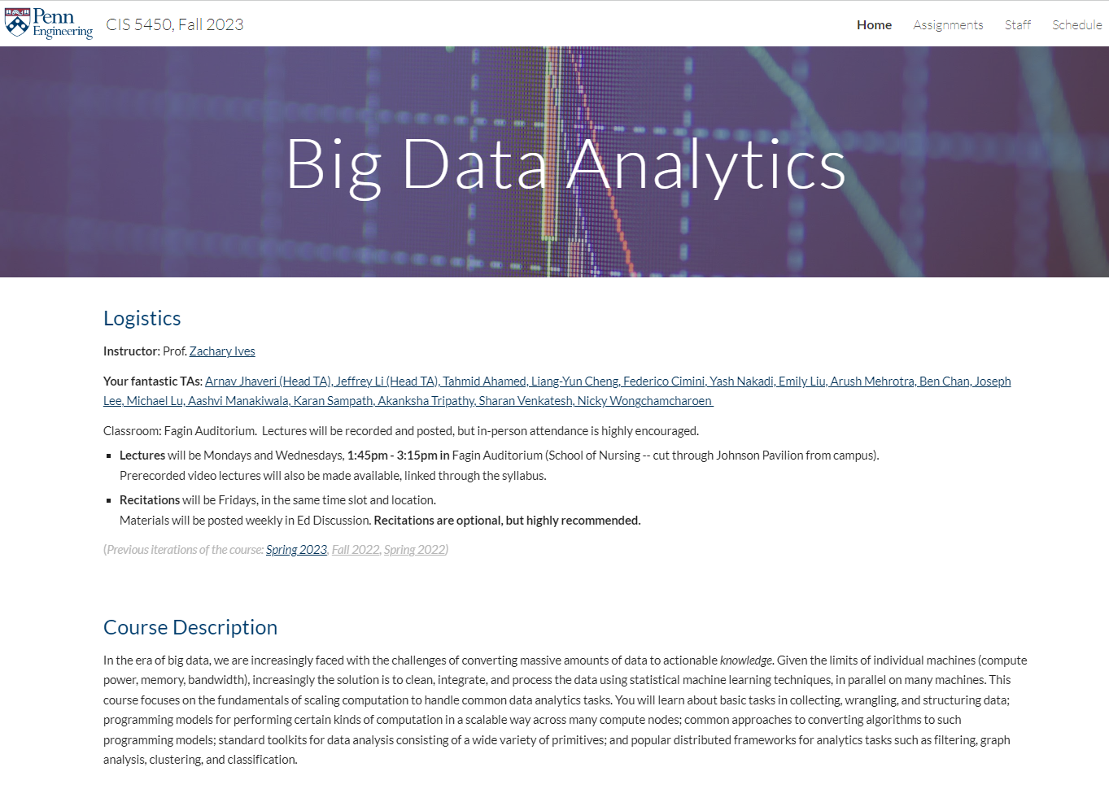
Course Website: cis.upenn.edu/~cis5450
Notes:
Clayton
CHANGE THIS
Up next: Feeback form

Slide 47
Who This Class is For
Students from engineering / science, applied math, social science, …
With solid but basic background in statistics, plus experience in Python programming
STAT 4300, EAS 3010 or equivalent, CIS 1050 or MCIT 5900 or equivalent
Students from computer science who want to understand how to analyze data
Many of you have had CIS 4190/5190/5200, some have had CIS 4500/5500
(Our recommended sequence is 5450 → 5190/5200 and 5500)
... Please bear with us as we try to accommodate both audiences! We’ll try to make sure we add a different perspective in each area
Notes:
Up next: other courses
Should we say who the course is NOT for?

Slide 48
Relationship to Other Courses at Penn
CIS 4500/5500 focuses on data modeling, querying
Data representation and management
Relational querying with SQL; XML querying with XQuery
DBMS-backed web sites
We will cover some data modeling and querying, but our focus is on Apache Spark and understanding how Python Pandas and SQL relate
CIS 4190/5190 and 5200 focus on machine learning algorithms and underlying theory
This course uses machine learning tools, and gives “just enough detail” to have a sense of the basic algorithms, how to use them, how to tune them
Our focus here is on dealing with compute clusters, heterogeneous data, scale, and visualization
CIS 4550/5550 shows how to build the platforms
Under the covers: how big data analytics systems are built
Build your own Web server, Google, MapReduce
Notes:
Up next: topic list

Slide 49
What You’ll Learn Here
Data manipulation in Python, its libraries, and the Spark platform
Data representation and wrangling
Data as graphs and matrices
Data ethics and privacy
Data cleaning, hypothesis testing, …
Use of common algorithmic patterns and learning primitives
Clustering and unsupervised learning
Training and classification
Managing time-varying data
Deep learning
Some data visualization
This is not (exactly) a machine learning course
This is not (exactly) a database course
But you’ll learn how to apply both!
Notes:
Up next: textbooks

Slide 50
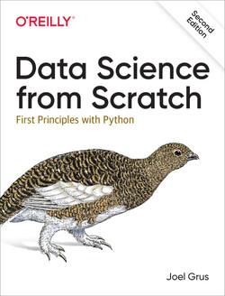
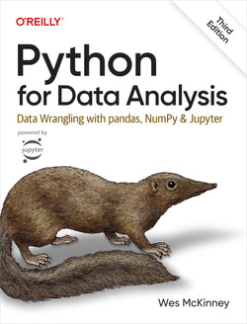
Reference Books
We will use the following books, plus supplemental readings
Data Science from Scratch, 2nd ed, by Joel Grus. O'Reilly
Python for Data Analysis, 3rd ed by Wes McKinney. O'Reilly
(if you have a non-CS background)
(for everyone)
Notes:
Up next: prereqs and workload (C)

Slide 51
Prerequisites, Workload, etc.
Necessary skills:
Comfort with coding in Python (we won’t be writing huge programs)
A willingness to take the general principles you’ve learned in lecture, and learn the hands-on details of libraries in the homeworks
Attention to detail
A willingness to “push the envelope”
Workload:
Multiple notebook-based homework assignments
A term project with an experimental report (roughly analogous to Kaggle competitions)
Two midterms, one taken as a final exam
Payoff is based on how much you put in:
Lots of hands-on experience with data analysis and data tools / techniques
Notes:
Up next: Disclaimer (S)

Slide 52
A Disclaimer…
The field continues to evolve, and so does this course
We are trying to balance breadth and depth, and a diverse set of students and goals!
We will be using some immature technology
Not everything will have been validated ahead of time
We’ll do the best we can to smooth over the bugs!
We hope it will be a fun course, though…
… And an interesting one!
Notes:
Up next: Technologies (Z)+

Slide 53
Technologies
We’ll make heavy use of the Python data science ecosystem
Generally hosted on Google Colab
Using Jupyter as an integrated environment, with a cloud based PennGrader
We’ll do some tasks on Amazon & Google’s cloud services
And Apache Spark for parallel programming, D3 for custom visualization
Scikit-learn, Pandas, PySpark, langchain, …
Also, some use of Pytorch, Apache mxNet with relevance to other platforms
Notes:
Sue

Slide 54
For All Meetings with Us (In-Person + Remote)
Please go to https://ohq.io and sign up for CIS 5450 (OHQ doesn’t allow signups to direct course links)
BEWARE to not sign up for the online version of the course
Then add yourself to the queue, so we can balance between in-person and remote visitors!

Slide 55
Grading (Tentative)
5 homework assignments + Homework 0 (40%)
Midterm 1, in October, 80 minutes (15%)
Midterm 2, finals week, 80 minutes (15%)
Kaggle-competition-style term project (20%)
Quizzes (answers will be discussed in class!) (7%)
Participation: participating in class, activity on Piazza (3%)

Slide 56
This Week: Get Started with Google Colab and HW0
As you’ve probably discovered: course web is at www.cis.upenn.edu/~cis5450 Sign up for Ed Discussion and OHQ, log into Canvas
Please read “What Data Scientists Really Do, What Does a Data Engineer Do?”
Get started on Homework 0 to familiarize yourself with Colab
Friday: “getting started in Python / Colab” recitation

